Slide 1
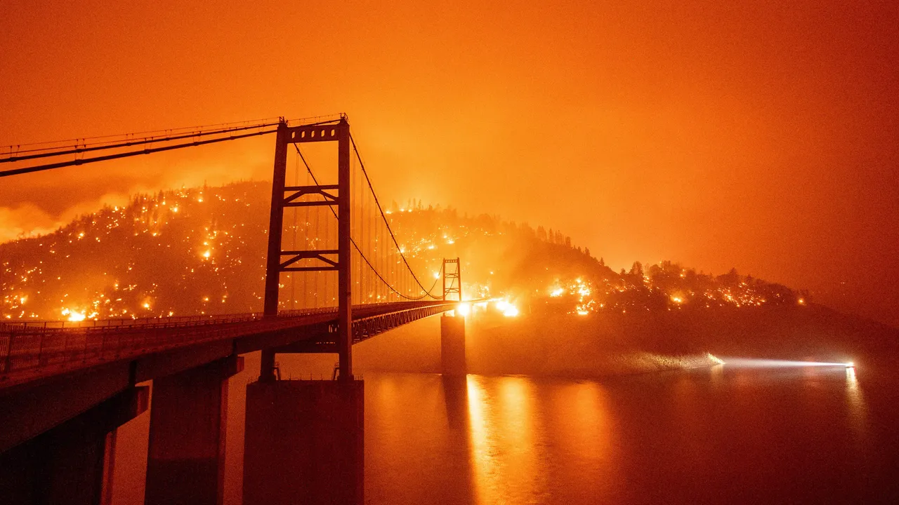
Air Quality Final Project
Robert Vander Weele
Martin Landeros
Bhavna Singh
Tahani Sury
Image credit: Vogue - Sep 9th, 2020 – San Francisco

Slide 2
Why is Air Quality important?
Air pollution is a health risk
It can cause respiratory diseases and/or cancer
It can cause heart diseases and strokes
It can affect people’s ability or opportunity to be physically active
Air in its purest state is best for life sustaining tasks
AQI (Air Quality Index) gives daily air quality reports which tells us how polluted or clean the air quality is in your area
Millions of people in the U.S. are exposed to unhealthy quality of air every year.
Ozone and particle pollution are the two most widespread air pollutants of concern.
Notes:
Having clean air to breathe is necessary for good health. Poor air quality reduces quality of life. Some air pollutants are irritants. Some smell bad. Some air pollutants can cause respiratory disease or even cancer

Slide 3
Particulate Matter - What Is It?
Ambient air quality standards have been set for PM10 and PM2.5.
Both consist of different types of particles suspended in the air, such as metal, soot, smoke, dust and fine mineral particles. The particles’ toxicity and chemical activity can vary, depending on the source.
The primary source of PM10 emissions appears to be from the soil via road use, construction, agriculture, and natural windblown dust.
Other sources include sea salt, combustion processes (such as those in gasoline or diesel vehicles), and wood burning.
Primary sources of PM2.5 emissions come from construction sites, wood stoves, fireplaces and diesel truck exhaust.
Particulate matter with a diameter of 10 microns or less (PM10), and particulate matter with a diameter of 2.5 microns or less (PM2.5).
Particulate matter is a health concern because when inhaled it can cause permanent lung damage. (EPA 2021)

Slide 4
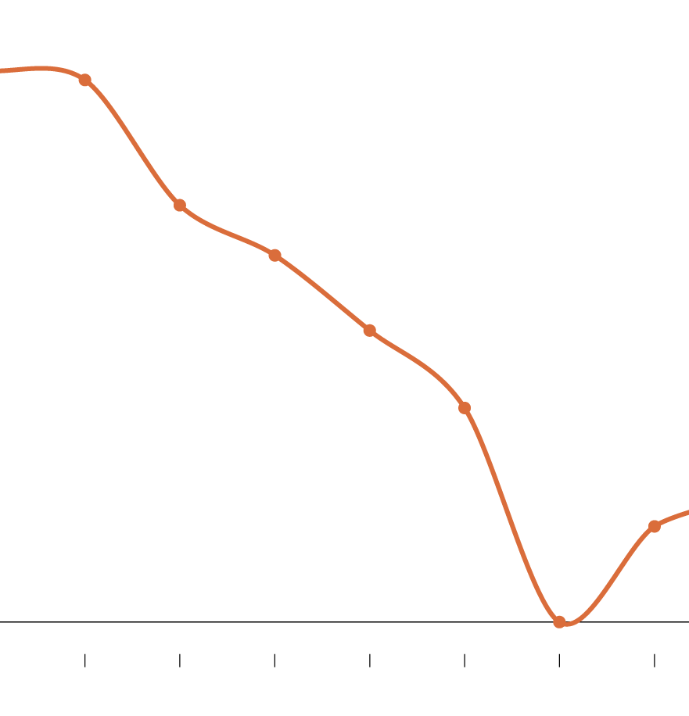
How Has Air Quality Been in the Past
Air quality pollutants had a rise during the World Wars and Industrialization
This became a catalyst for global warming.
Although the air quality around the globe had improved since the World Wars, global warming is still an issue (Filtermist 2019)
Melting of glaciers are now cause Methane to be released into the air – that was once frozen in time, literally.
Since 2016, Air Quality has started to become worse
Today, wildfires are one of the main reasons for unhealthy/dangerous level of air quality.
2011
2012
2013
2014
2015
2016
2017
Popovich, 2019

Slide 5
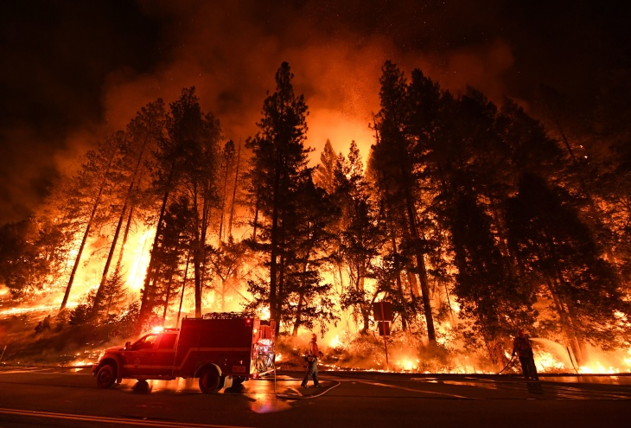
Causes of Wildfires
Rising temperatures
Drought conditions
Dry vegetation
Fuel - Any flammable material surrounding a fire, which can come in the form of live or dead trees, dry vegetation and other organic matter;
Air: An abundance of oxygen supply (fuels an already ignited fire)
Heat sources: to ignite and burn the fuel. This could take the form of lightning strikes or human sources such as campfires or cigarettes. (Lai, 2021)
Image Credit: AFP/Getty Images

Slide 6
California Counties Researched for This Project for Years 2019-2020 Due to Wildfires – Particulate Matter 10
Alameda – Urban
Los Angeles – Urban
San Luis Obispo – Rural
Fresno – Agricultural/Rural
Inyo – Rural/Mountain/Desert
Shasta – Rural/Mountain
Placer - Suburban
Sacramento – Suburban/Urban
El Dorado – Mountain/Rural/Suburban

Slide 7

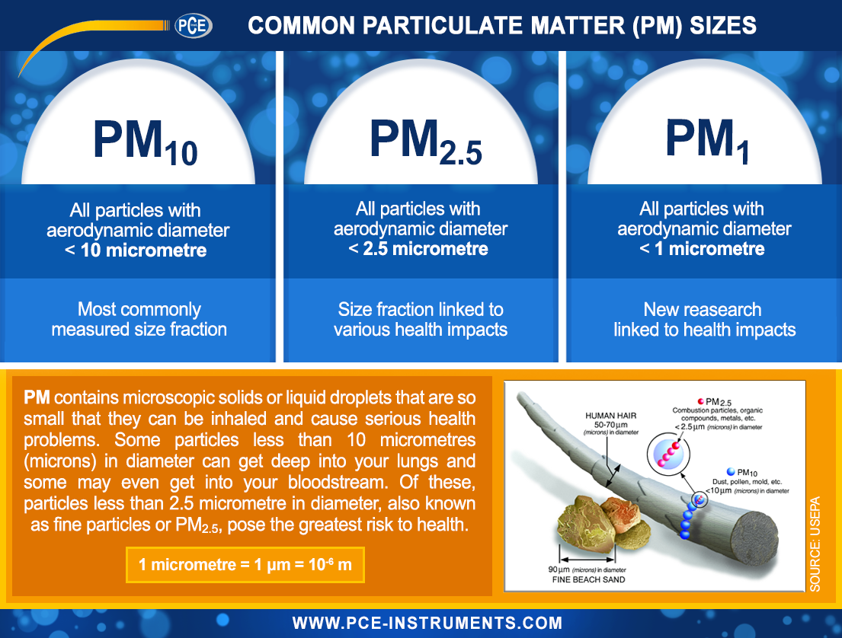
PM Emission Scale/Calculation
EPM = Q x S x (1 - TE) x (1 - CE) Eq. (1)
EPM = Emissions of particulate matter (lbs)
Q = Quantity of coatings applied (gallons or pounds)
S (1) = Solid content (lb/gal or lb/lb) in coatings
TE (2) = Transfer Efficiency (decimal)
CE (3) = Control System Efficiency (decimal)

Slide 8
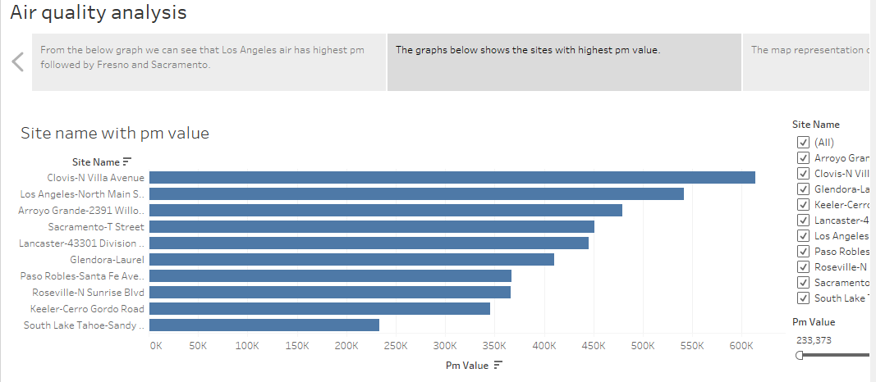
Site Names with Particulate Matter Values

Slide 9

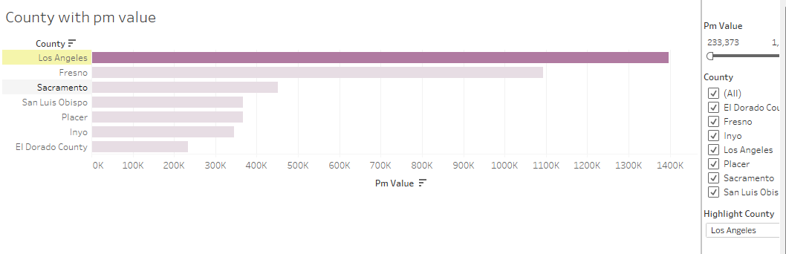

Slide 10

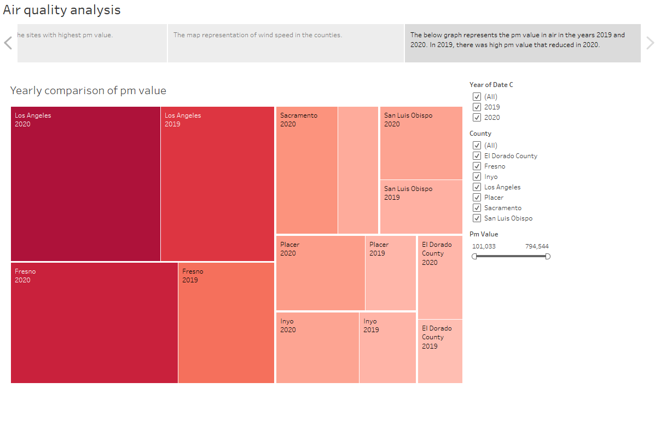

Slide 11

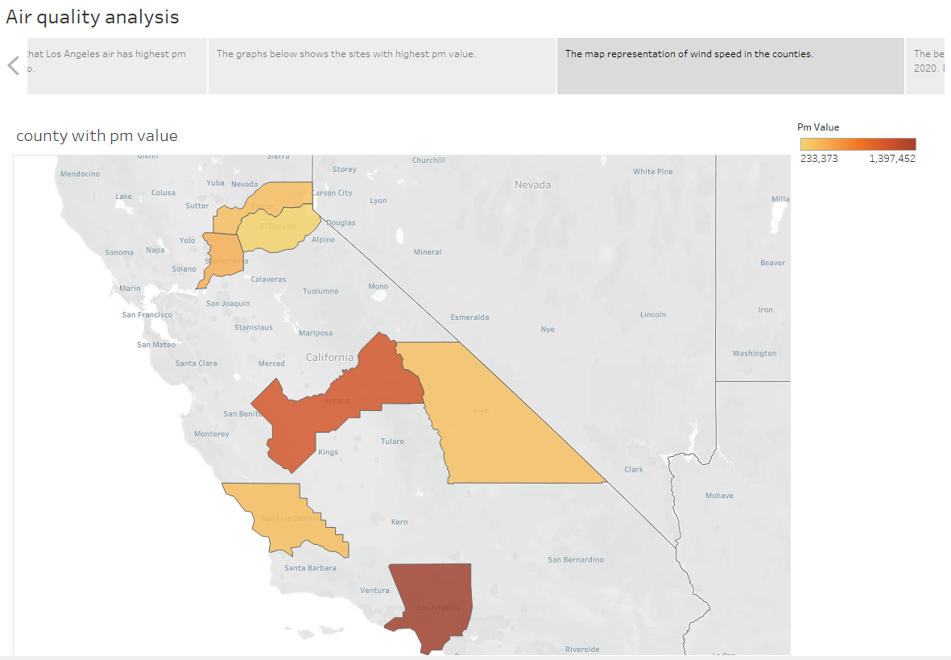

Slide 12
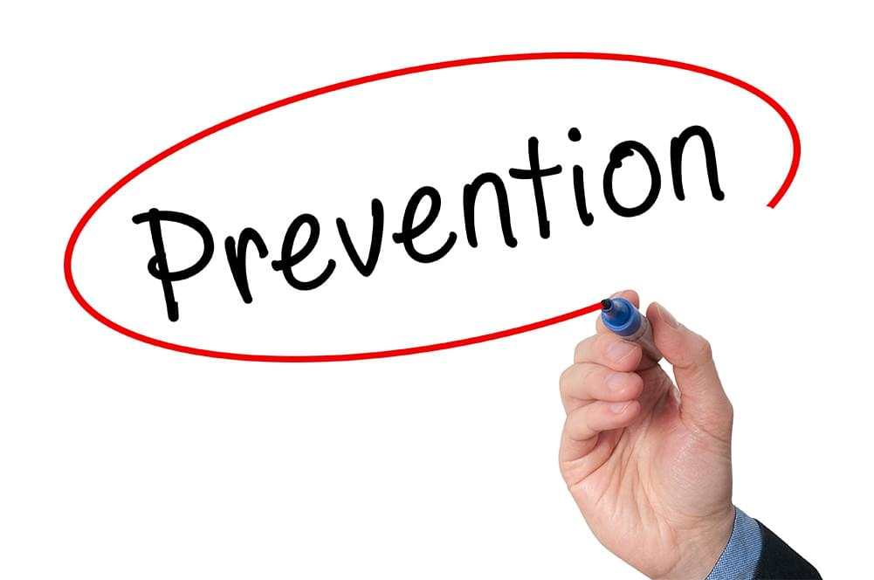
What You Can Do To Prevent Wildfires
*It only takes a spark!*
Check weather and drought conditions
Avoid activities that involves fire or sparks when its hot, dry, and windy
Build your campfire in an open location far from flammables and then douse your campfire until it’s cold
Regularly maintain your equipment and vehicle
They can shoot sparks from exhausts
Keep sparks away from dry vegetation (including cigarettes)
Secure your property for a wildfire
Limit fuel sources around your home or business

Slide 13
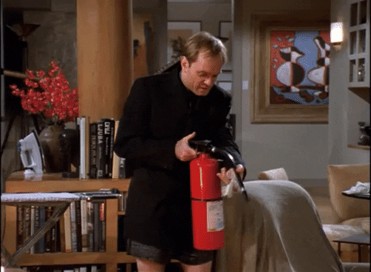
During And After Wildfires
Prepare to evacuate
Pay attention to emergency channels. Put emergency supplies and must-have items in the car so you can evacuate quickly.
Moving furniture to the center of rooms and taking down drapes and curtains to prevent combustion.
Closing all windows and doors to prevent drafts and reduce heat.
Shutting off natural gas from its source.
Turning on all lights in your property so that firefighters can more easily see it through smoke.
When driving during wildfire, keep windows rolled up and close air vent.
Carry respirator masks (N95s)
After a wildfire
Return only when it is safe to do so
Document the damages
Wear respirator masks (N95s) until AQI show safe air quality

Slide 14
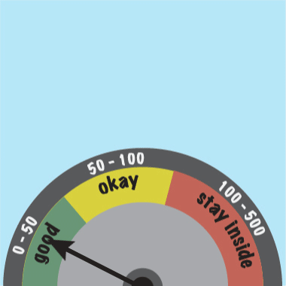
Do’s and Don’t for Poor Air Quality
Check daily Air Quality Index forecast in your area
Avoid exercising outdoors when AQI is unhealthy or near high-traffic areas
Use less energy at home
Walk, bike, or carpool – combine tripes – gives out less emission
Don’t burn wood or trash
Use hand-powered or electric lawn care equipment instead of gasoline-powered ones
Do not smoke indoors
Wear N95’s when outside in an unhealthy air quality area
Try to stay indoors during unhealthy air quality forecasts. (American Lung Association, 2022)
Gif credit – NASA Climate Change

Slide 15
Conclusion
In 2019 alone, California has had a 7860 cases of wildfire (Cal Fire, 2019)
In 2020, California has had 8648 cases of wildfire recorded (Cal Fire, 2020)
Wildfires in 2019-2020 in the listed researched California counties has directly affected its air quality and quality of life of the people living there.
According to the data - Los Angeles, Fresno, and Sacramento counties are the top 3 that have the worst air quality due to wildfires within or near the researched counties
Data Limitations:
We need updated data on numbers of deaths from existing heart and lung diseases relating to poor air quality in 2019-2020
We need updated data on numbers of new diagnoses of heart and lung diseases following a major wildfire in 2019-2020

Slide 16
References
10 tips to prevent wildfires. U.S. Department of the Interior. (2022, May 10). Retrieved July 8, 2022, from https://www.doi.gov/blog/10-tips-prevent-wildfires
10 tips to protect yourself from unhealthy air. American Lung Association. (n.d.). Retrieved July 10, 2022, from https://www.lung.org/clean-air/outdoors/10-tips-to-protect-yourself
California Department of Forestry and Fire Protection (CAL FIRE). (n.d.). 2019 incident archive. Cal Fire Department of Forestry and Fire Protection. Retrieved July 9, 2022, from https://www.fire.ca.gov/incidents/2019/
Donohue, A. (2018, August 30). The do's and don'ts of wildfires. I'd Hike That. Retrieved July 9, 2022, from https://www.idhikethat.com/blogs/hiking-blog/dos-donts-wildfires
Donohue, A. (2018, August 30). The do's and don'ts of wildfires. I'd Hike That. Retrieved July 9, 2022, from https://www.idhikethat.com/blogs/hiking-blog/dos-donts-wildfires
Environmental Protection Agency. (2021, May 26). Particulate Matter (PM) Basics. EPA. Retrieved July 8, 2022, from https://www.epa.gov/pm-pollution/particulate-matter-pm-basics
Filtermist Global News. Filtermist. (2019, June 4). Retrieved July 8, 2022, from https://www.filtermist.com/news/post/2019/06/04/air-pollution-over-the-last-50-years
Lai, O. (2021, November 12). What Causes California Wildfires?: Earth.org - Past: Present: Future. Earth.Org - Past | Present | Future. Retrieved July 8, 2022, from https://earth.org/what-causes-california-wildfires/#:~:text=Rising%20temperatures%2C%20drought%20conditions%20and,fire%20season%20in%20the%20state.
Popovich, N. (2019, October 24). America's air quality worsens, ending years of gains, study says. The New York Times. Retrieved July 8, 2022, from https://www.nytimes.com/interactive/2019/10/24/climate/air-pollution-increase.html
Wildfire Safety Tips | wildfire precautions | the Hartford. The Hartford. (n.d.). Retrieved July 7, 2022, from https://www.thehartford.com/claims/wildfire-safety

Slide 17


